Slide 1

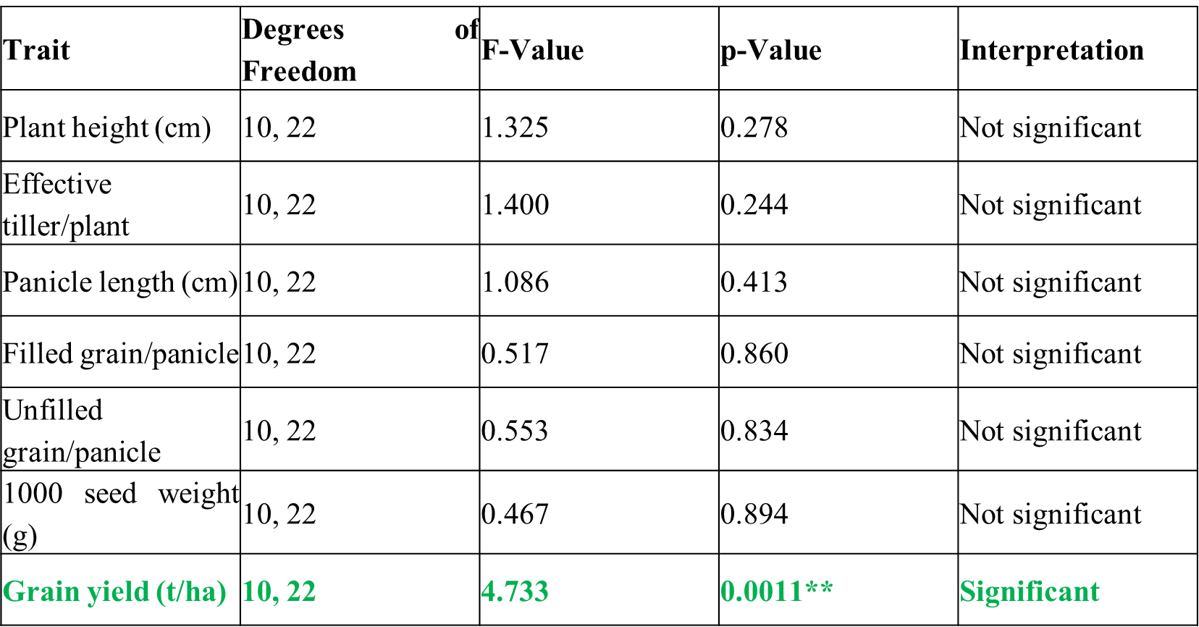
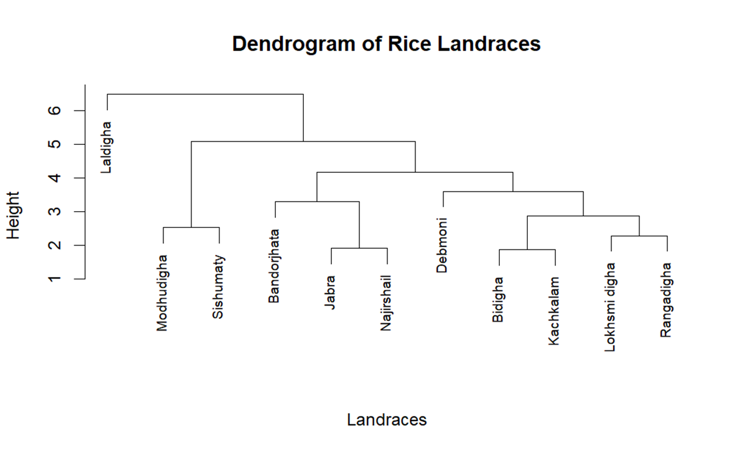
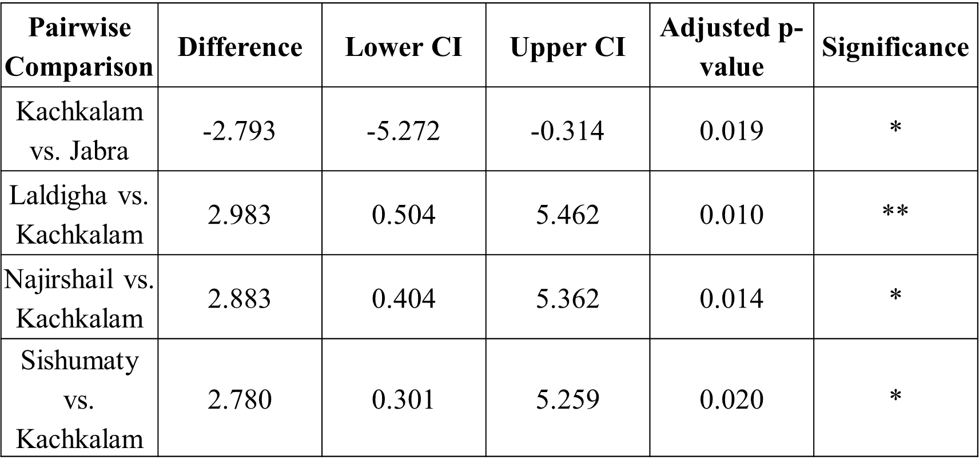
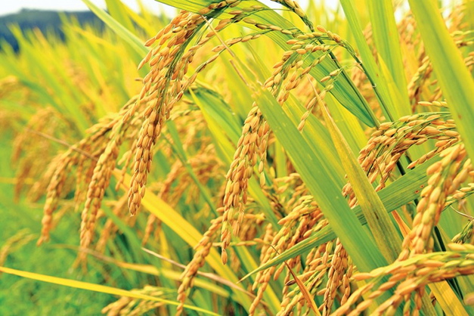
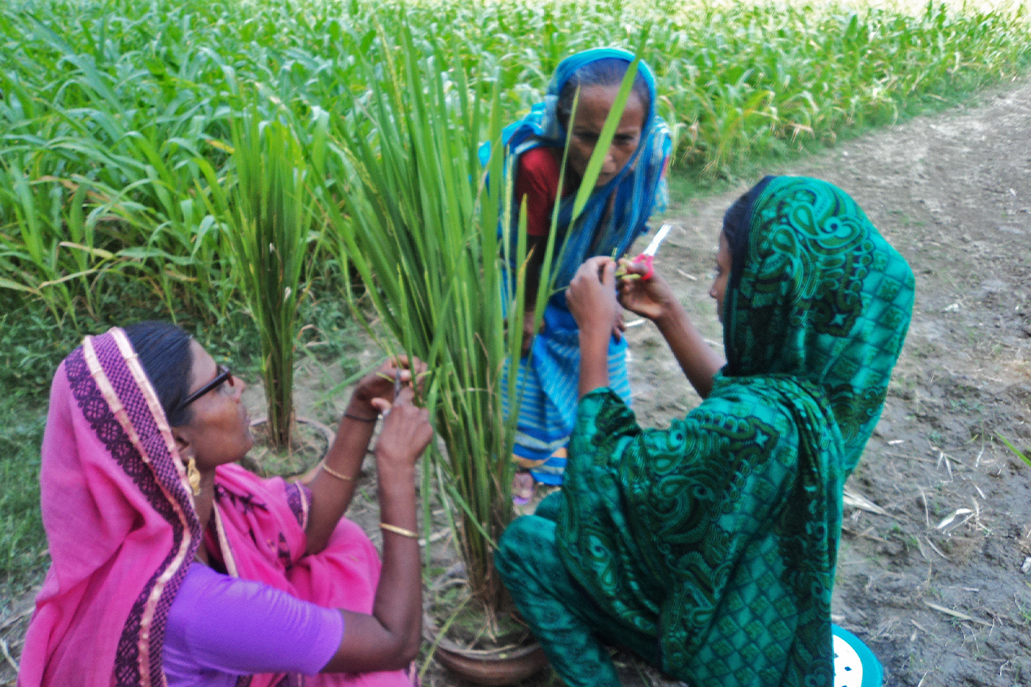
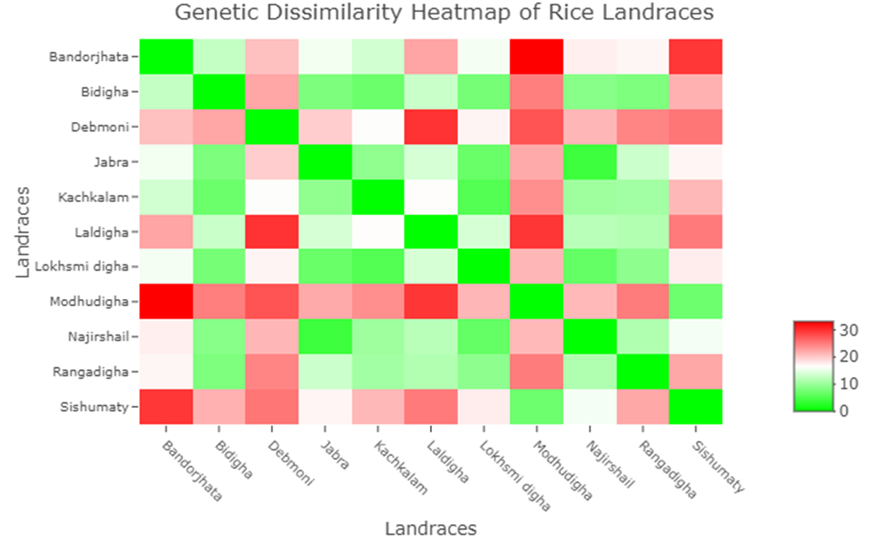
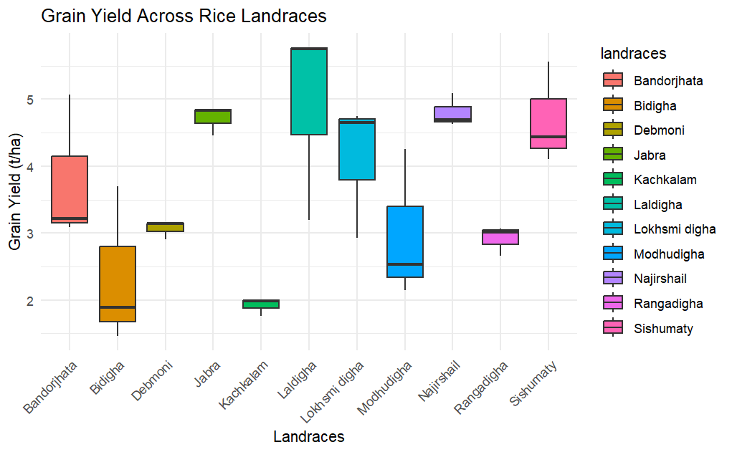
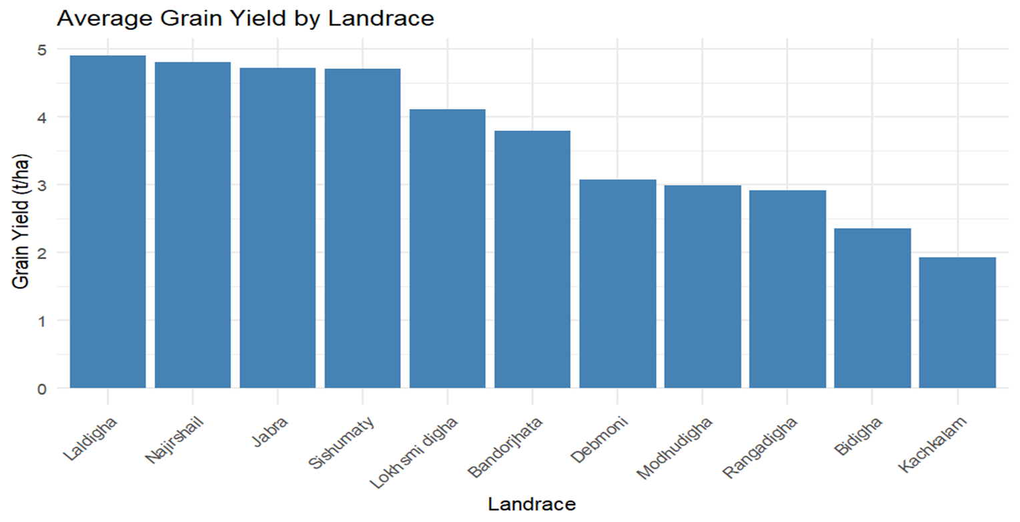
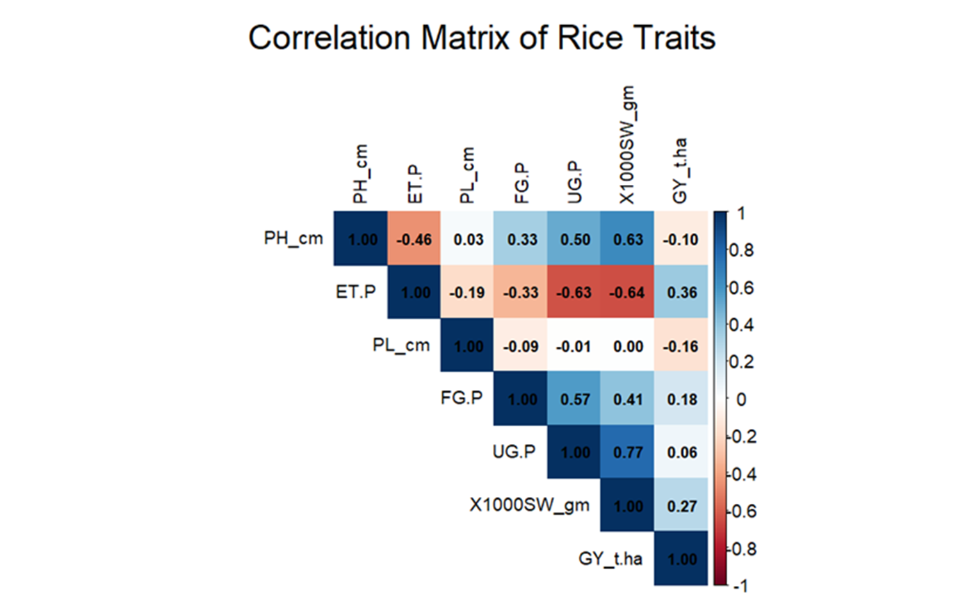
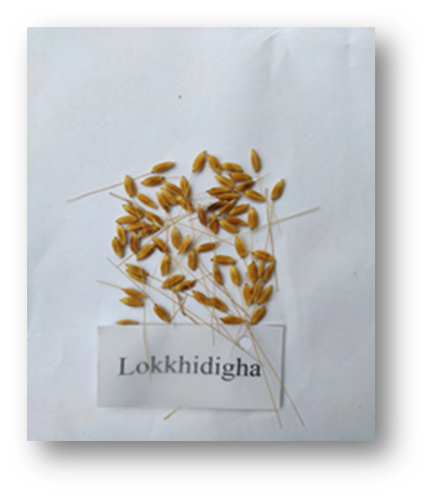
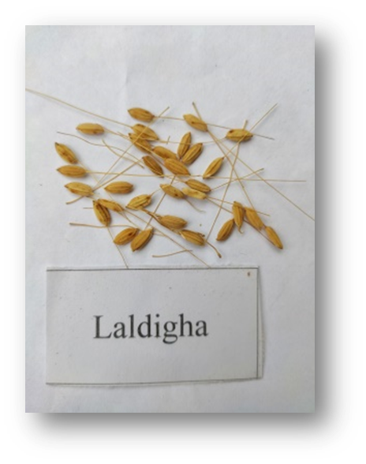
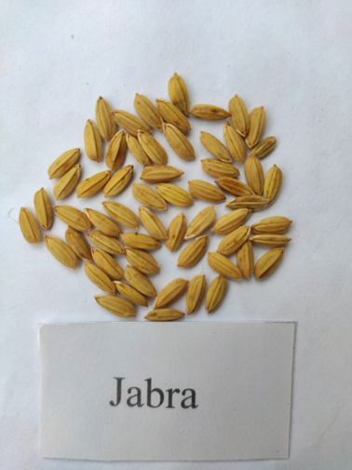
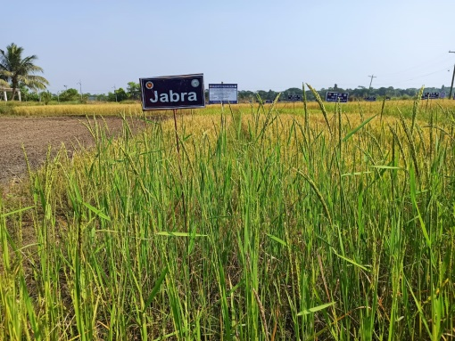
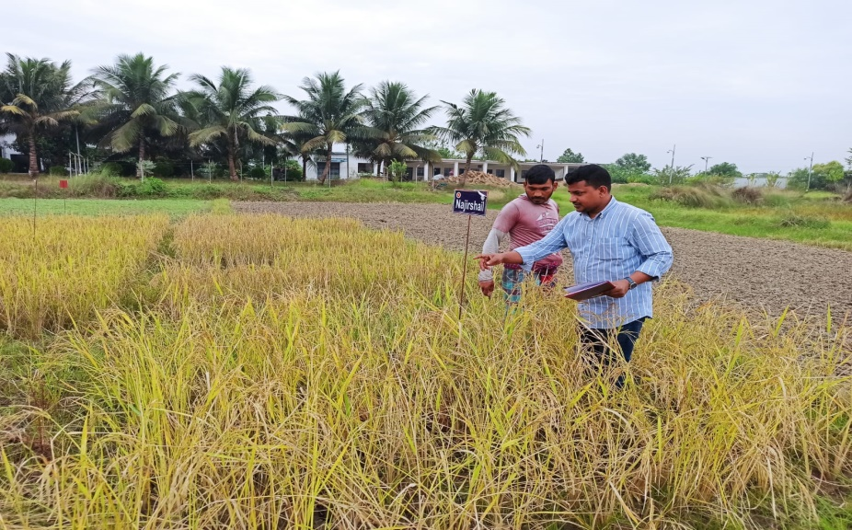
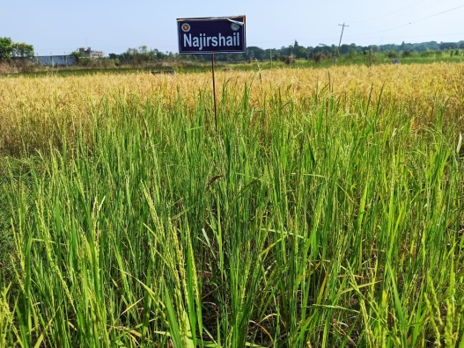
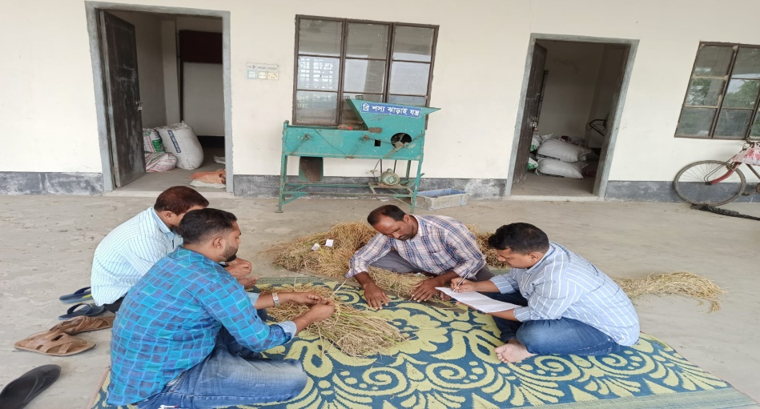
Characterization of Local Rice Landraces at Greater Faridpur Region in Bangladesh for useful gene pool
BIOL 806
MD ROBIUL ISLAM AKONDO and MD SEIKH SADIUL ISLAM TANVIR
INTRODUCTION
RESULT AND DISCUSSION
RESULT AND DISCUSSION
BD (75% of Agricultural land for rice cultivation)
Rice landraces (plant breeding program)
Plant height, tiller number, and drought tolerance (key character)
Sustainable agriculture and breeding programs.
This study analyzed 11 rice landraces from the Faridpur region
ANOVA Summary for Agronomic Traits of Rice Landraces
Laldigha forms an independent cluster
Modhudigha and Sishumaty are grouped together
Tukey HSD Post-hoc Test Results for Grain Yield (t/ha)
RATIONALE
BD (8000 traditional rice varieties)
Resistance to biotic and abiotic stress
Survive under adverse climatic circumstances.
Breeding programs or studies on conservation measures
Green (low dissimilarity) to red (high dissimilarity)
Modhudigha Highest Genetic dissimilarity
Bandorjhata and Debmoni show high similarity
Jabra and Sishumaty exhibit a mix of intermediate dissimilarity
OBJECTIVES
Range of Grain Yield Across Rice Landraces
Evaluate their genetic diversity and potential for crop improvement.
MATERIALS AND METHODS
BINA Sub-station, Gopalganj
89.76 °E longitude and 23.11 °N latitude, subtropical climate
Soil had a clay loam texture
Growing Season: Aman-2020, 2021, and 2022
RCBD
Three replications
25-day-old seedlings
(3×2) m2 plot
Two seedling per hill
Spacing: Row to row 25 cm and Plant to plant 20 cm
Recommendation
Average Grain Yield Across Rice Landraces
Cultivar Laldigha, Lokhsmi digha, and Jabra can be used for further breeding program.
Plant Height (PH) exhibited a strong positive correlation with 1000-seed weight
Unfilled grains per panicle
Tillers per Plant (ET. P) showed negative correlations with most traits

